Slide 1
_{Bones and Skeletal Tissues}
Prepared by I Gede Purnawinadi, S.Kep.,M.Kes.

Slide 2
Skeletal Cartilages
Basic Structure, Types, and Locations
A skeletal cartilage is made of some variety of cartilage tissue, which consists primarily of water. The high water content of cartilage accounts for its resilience, that is, its ability to spring back to its original shape after being compressed.
The cartilage, which contains no nerves or blood vessels, is surrounded by a layer of dense irregular connective tissue, the perichondrium (per″ĭ-kon′dre-um; “around the cartilage”).
The perichondrium acts like a girdle to resist outward expansion when the cartilage is compressed.
Additionally, the perichondrium contains the blood vessels from which nutrients diffuse through the matrix to reach the cartilage cells.

Slide 3
There are three types of cartilage tissue in the body: hyaline, elastic, and fibrocartilage. All three types have the same basic components—cells called chondrocytes,
Hyaline cartilages
which look like frosted glass when freshly exposed, provide support with flexibility and resilience.
They are the most abundant skeletal cartilages. When viewed under the microscope, their chondrocytes appear spherical. The only fiber type in their matrix is fine collagen fibers (which, however, are not detectable microscopically).
Skeletal hyaline cartilages include (1) articular cartilages, which cover the ends of most bones at movable joints; (2) costal cartilages, which connect the ribs to the sternum (breastbone); (3) respiratory cartilages, which form the skeleton of the larynx (voicebox), and reinforce other respiratory passageways; and (4) nasal cartilages, which support the external nose.

Slide 4
Elastic cartilages
look very much like hyaline cartilages, but they contain more stretchy elastic fibers and so are better able to stand up to repeated bending.
They are found in only two skeletal locations - the external ear and the epiglottis (the flap that bends to cover the opening of the larynx each time we swallow).
Fibrocartilages
are highly compressible and have great tensile strength. The perfect intermediate between hyaline and elastic cartilages, fibrocartilages consist of roughly parallel rows of chondrocytes alternating with thick collagen fibers.
Fibrocartilages occur in sites that are subjected to both heavy pressure and stretch, such as the padlike cartilages (menisci) of the knee and the discs between vertebrae.

Slide 5
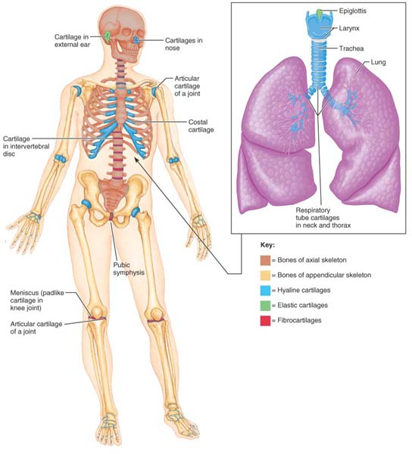

Slide 6
Classification of Bones
The 206 named bones of the human skeleton are divided into two groups: axial and appendicular.
The axial skeleton forms the long axis of the body and includes the bones of the skull, vertebral column, and rib cage. Generally speaking these bones are most involved in protecting, supporting, or carrying other body parts.
The appendicular skeleton (ap″en-dik′u-lar) consists of the bones of the upper and lower limbs and the girdles (shoulder bones and hip bones) that attach the limbs to the axial skeleton. Bones of the limbs help to get us from place to place (locomotion) and to manipulate our environment.

Slide 7
Bones come in many sizes and shapes, for the most part, bones are classified by their shape as long, short, flat, and irregular:
Long bones, as their name suggests, are considerably longer than they are wide. A long bone has a shaft plus two ends. All limb bones except the patella (kneecap) and the wrist and ankle bones are long bones. Notice that these bones are named for their elongated shape, not their overall size. The three bones in each of your fingers are long bones, even though they are very small.
Short bones are roughly cube shaped. The bones of the wrist and ankle are examples, are a special type of short bone that form in a tendon (for example, the patella).
Flat bones are thin, flattened, and usually a bit curved. The sternum (breastbone), scapulae (shoulder blades), ribs, and most skull bones are flat bones.
Irregular bones have complicated shapes that fit none of the preceding classes. Examples include the vertebrae and the hip bones.

Slide 8
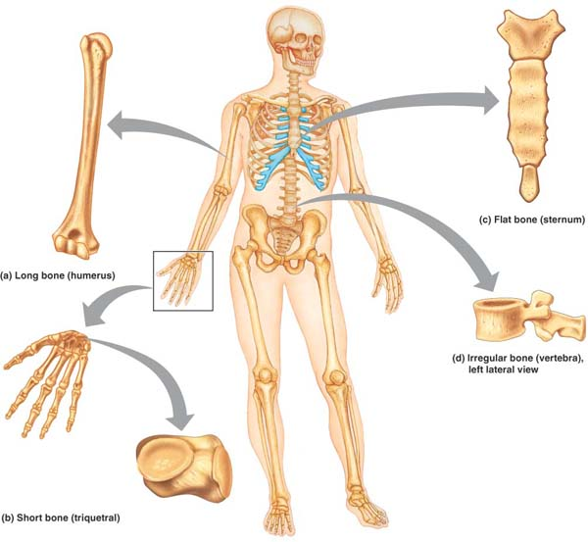

Slide 9
Functions of Bones
Support. Bones provide a framework that supports the body and cradles its soft organs. For example, bones of lower limbs act as pillars to support the body trunk when we stand, and the rib cage supports the thoracic wall.
Protection. The fused bones of the skull protect the brain. The vertebrae surround the spinal cord, and the rib cage helps protect the vital organs of the thorax.
Movement. Skeletal muscles, which attach to bones by tendons, use bones as levers to move the body and its parts. As a result, we can walk, grasp objects, and breathe. The design of joints determine the types of movement possible.
Mineral and growth factor storage. Bone is a reservoir for minerals, most importantly calcium and phosphate. The stored minerals are released into the bloodstream as needed for distribution to all parts of the body. Indeed, “deposits” and “withdrawals” of minerals to and from the bones go on almost continuously. Additionally, mineralized bone matrix stores important growth factors such as insulin-like growth factors, transforming growth factor, bone morphogenic proteins, and others.
Blood cell formation. Most blood cell formation, or hematopoiesis (hem″ah-to-poi-e′sis), occurs in the marrow cavities of certain bones.

Slide 10
Bone Structure
Because they contain various types of tissue, bones are organs. (Recall that an organ contains several different tissues.)
Although bone (osseous) tissue dominates bones, they also contain nervous tissue in their nerves, cartilage in their articular cartilages, fibrous connective tissue lining their cavities, and muscle and epithelial tissues in their blood vessels.
We will consider bone structure at three levels: gross, microscopic, and chemical.

Slide 11
Gross Anatomy
Bone Textures: Compact and Spongy Bone
Every bone has a dense outer layer that looks smooth and solid to the naked eye.
This external layer is compact bone. Internal to this is spongy bone (also called cancellous bone), a honeycomb of small needle-like or flat pieces called trabeculae (trah-bek′u-le; “little beams”).
In living bones the open spaces between trabeculae are filled with red or yellow bone marrow.

Slide 12
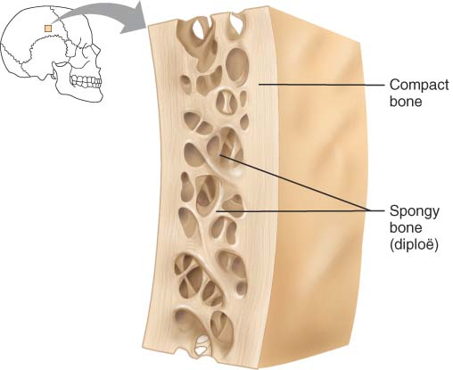

Slide 13
Structure of a Typical Long Bone
With few exceptions, all long bones have the same general structure.
Diaphysis.
A tubular diaphysis (di-af′ĭ-sis; dia = through, physis = growth), or shaft, forms the long axis of the bone.
It is constructed of a relatively thick collar of compact bone that surrounds a central medullary cavity (med′u-lar-e; “middle”) or marrow cavity. In adults, the medullary cavity contains fat (yellow marrow) and is called the yellow bone marrow cavity.
Epiphyses
The epiphyses (e-pif′ĭ-sēz; singular: epiphysis) are the bone ends (epi = upon).
In many cases, they are more expanded than the diaphysis. Compact bone forms the exterior of epiphyses; their interior contains spongy bone.

Slide 14
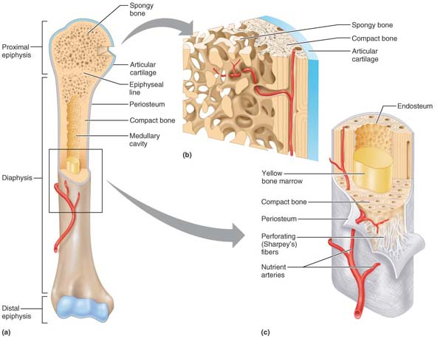
The structure of a long bone (humerus of arm).
Anterior view with bone sectioned frontally to show the interior at the proximal end.
Enlarged view of spongy bone and compact bone of the epiphysis of (a).
Enlarged cross-sectional view of the shaft (diaphysis) of (a). Note that the external surface of the diaphysis is covered by periosteum, but the articular surface of the epiphysis is covered with hyaline cartilage.

Slide 15
Structure of Short, Irregular, and Flat Bones
Short, irregular, and flat bones share a simple design: They all consist of thin plates of periosteum-covered compact bone on the outside and endosteum-covered spongy bone within.
However, these bones are not cylindrical and so they have no shaft or epiphyses. They contain bone marrow (between their trabeculae), but no significant marrow cavity is present.

Slide 16
Location of Hematopoietic Tissue in Bones
Hematopoietic tissue, red marrow, is typically found within the trabecular cavities of spongy bone of long bones and in the diploë of flat bones. For this reason, both these cavities are often referred to as red marrow cavities.
In newborn infants, the medullary cavity of the diaphysis and all areas of spongy bone contain red bone marrow.
In most adult long bones, the fat-containing medullary cavity extends well into the epiphysis, and little red marrow is present in the spongy bone cavities. Hence, blood cell production in adult long bones routinely occurs only in the heads of the femur and humerus (the long bone of the arm).
The red marrow found in the diploë of flat bones (such as the sternum) and in some irregular bones (such as the hip bone) is much more active in hematopoiesis, and these are the sites routinely used for obtaining red marrow samples when problems with the blood-forming tissue are suspected.
However, yellow marrow in the medullary cavity can revert to red marrow if a person becomes very anemic and needs enhanced red blood cell production.

Slide 17
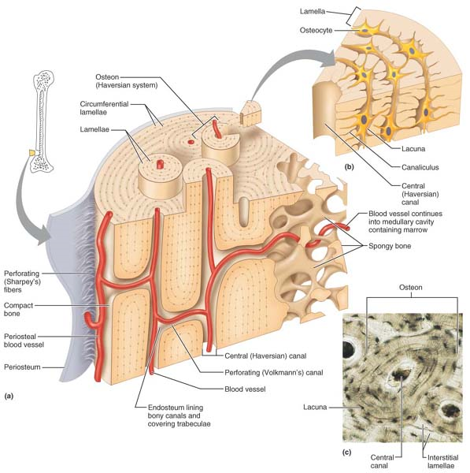
Microscopic anatomy of compact bone.
Diagrammatic view of a pie-shaped segment of compact bone.
Close-up of a portion of one osteon. Note the position of osteocytes in the lacunae.
Photomicrograph of a cross-sectional view of an osteon (140×).

Slide 18
Chemical Composition of Bone
Bone has both organic and inorganic components.
Its organic components include the cells (osteogenic cells, osteoblasts, osteocytes, and osteoclasts) and osteoid (os′te-oid), the organic part of the matrix.
These organic substances, particularly collagen, contribute not only to a bone’s structure but also to the flexibility and great tensile strength that allow the bone to resist stretch and twisting.
The balance of bone tissue (65% by mass) consists of inorganic hydroxyapatites (hi-drok″se-ap′ah-tītz), or mineral salts, largely calcium phosphates present in the form of tiny, tightly packed crystals in and around the collagen fibers in the extracellular matrix.
The crystals account for the most notable characteristic of bone—its exceptional hardness, which allows it to resist compression.

Slide 19
Bone Development
Ossification and osteogenesis (os″te-o-jen′ĕ-sis) are synonyms meaning the process of bone formation (os = bone, genesis = beginning).
In embryos this process leads to the formation of the bony skeleton.
Later another form of ossification known as bone growth goes on until early adulthood as the body continues to increase in size.
Bones are capable of growing in thickness throughout life. However, ossification in adults serves mainly for bone remodeling and repair

Slide 20
Formation of the Bony Skeleton
Before week 8, the skeleton of a human embryo is constructed entirely from fibrous membranes and hyaline cartilage.
Bone tissue begins to develop at about this time and eventually replaces most of the existing fibrous or cartilage structures.
When a bone develops from a fibrous membrane, the process is intramembranous ossification, and the bone is called a membrane bone.
Bone development by replacing hyaline cartilage is called endochondral ossification (endo = within, chondro = cartilage), and the resulting bone is called a cartilage, or endochondral, bone.

Slide 21
Intramembranous Ossification
Intramembranous ossification results in the formation of cranial bones of the skull (frontal, parietal, occipital, and temporal bones) and the clavicles.
All bones formed by this process are flat bones.
Fibrous connective tissue membranes formed by mesenchymal cells are the supporting structures on which ossification begins at about week 8 of development

Slide 22
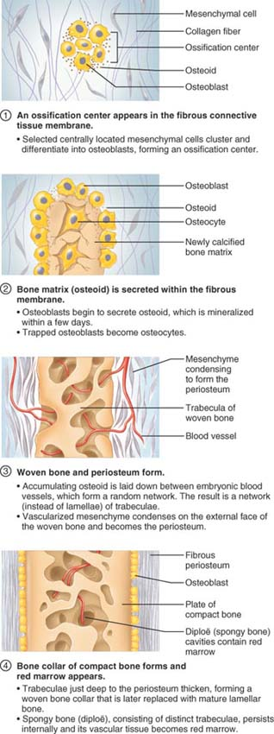

Slide 23
Endochondral Ossification
Except for the clavicles, essentially all bones of the skeleton below the base of the skull form by endochondral ossification (en″do-kon′dral).
This process, which begins in the second month of development, uses hyaline cartilage “bones” formed earlier as models, or patterns, for bone construction. It is more complex than intramembranous ossification because the hyaline cartilage must be broken down as ossification proceeds. We will use a forming long bone as our example.
The formation of a long bone typically begins in the center of the hyaline cartilage shaft at a region called the primary ossification center.
First, the perichondrium covering the hyaline cartilage “bone” is infiltrated with blood vessels, converting it to a vascularized periosteum. As a result of this change in nutrition, the underlying mesenchymal cells specialize into osteoblasts.
The stage is now set for ossification to begin,

Slide 24
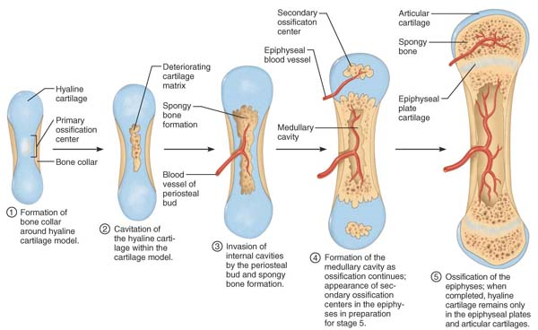

Slide 25
Postnatal Bone Growth
During infancy and youth, long bones lengthen entirely by interstitial growth of the epiphyseal plates, and all bones grow in thickness by appositional growth.
Most bones stop growing during adolescence; however, some facial bones, such as those of the nose and lower jaw, continue to grow almost imperceptibly throughout life.

Slide 26
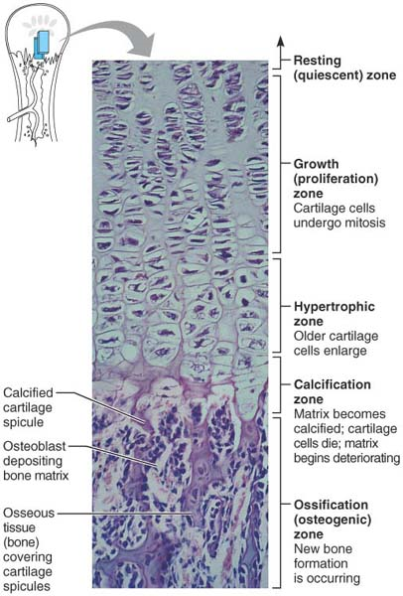
Growth in length of a long bone.
The side of the epiphyseal plate facing the epiphysis (distal face) contains resting cartilage cells.
The cells of the epiphyseal plate proximal to the resting cartilage area are arranged in four (80×). zones—
growth, hypertrophic, calcification, and ossification

Slide 27
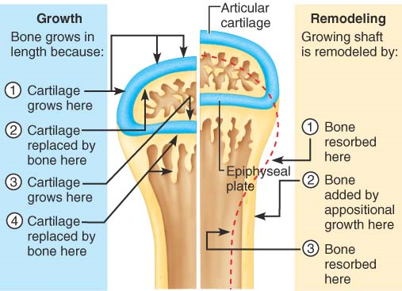
Long bone growth and remodeling during outh.
The events at the left depict endochondral ossification that occurs at the articular cartilages and epiphyseal plates as the bone grows in length.
Events at the right show bone remodeling during long bone growth to maintain proper bone proportions.

Slide 28
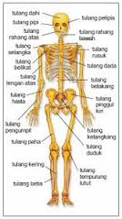
As adolescence draws to an end, the chondroblasts of the epiphyseal plates divide less often and the plates become thinner and thinner until they are entirely replaced by bone tissue. Longitudinal bone growth ends when the bone of the epiphysis and diaphysis fuses.
This process, called epiphyseal plate closure, happens at about 18 years of age in females and 21 years of age in males.

Slide 29
Hormonal Regulation of Bone Growth
The growth of bones that occurs until young adulthood is exquisitely controlled by a symphony of hormones.
During infancy and childhood, the single most important stimulus of epiphyseal plate activity is growth hormone released by the anterior pituitary gland.
Thyroid hormones modulate the activity of growth hormone, ensuring that the skeleton has proper proportions as it grows.
At puberty, male and female sex hormones (testosterone and estrogens, respectively) are released in increasing amounts. Initially these sex hormones promote the growth spurt typical of adolescence, as well as the masculinization or feminization of specific parts of the skeleton. Later the hormones induce epiphyseal plate closure, ending longitudinal bone growth.
Excesses or deficits of any of these hormones can result in obviously abnormal skeletal growth. For example, hypersecretion of growth hormone in children results in excessive height (gigantism), and deficits of growth hormone or thyroid hormone produce characteristic types of dwarfism.

Slide 30
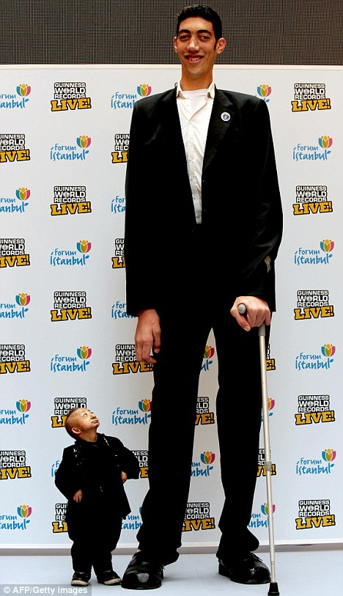

Slide 31
Bone Homeostasis: Remodeling and Repair
Bones appear to be the most lifeless of body organs, and may even summon images of a graveyard. But as you have just learned, appearances can be deceiving. Bone is a dynamic and active tissue, and small-scale changes in bone architecture occur continually. Every week we recycle 5–7% of our bone mass, and as much as half a gram of calcium may enter or leave the adult skeleton each day! Spongy bone is replaced every three to four years; compact bone, every ten years or so. This is fortunate because when bone remains in place for long periods the calcium crystallizes and becomes more brittle—ripe conditions for fracture. And when we break bones—the most common disorder of bone homeostasis—they undergo a remarkable process of self-repair.

Slide 32
Bone Remodeling
In the adult skeleton, bone deposit and bone resorption (removal) occur both at the surface of the periosteum and the surface of the endosteum. Together, the two processes constitute bone remodeling, and they are coupled and coordinated by “packets” of adjacent osteoblasts and osteoclasts called remodeling units (with help from the stress-sensing osteocytes). In healthy young adults, total bone mass remains constant, an indication that the rates of bone deposit and resorption are essentially equal. Remodeling does not occur uniformly, however. For example, the distal part of the femur, or thigh bone, is fully replaced every five to six months, whereas its shaft is altered much more slowly. Bone deposit occurs wherever bone is injured or added bone strength is required. For optimal bone deposit, a healthy diet rich in proteins, vitamin C, vitamin D, vitamin A, and several minerals (calcium, phosphorus, magnesium, and manganese, to name a few) is essential.

Slide 33
New matrix deposits by osteocytes are marked by the presence of an osteoid seam, an unmineralized band of gauzy-looking bone matrix 10–12 µm wide. Between the osteoid seam and the older mineralized bone, there is an abrupt transition called the calcification front. Because the osteoid seam is always of constant width and the change from unmineralized to mineralized matrix is sudden, it seems that the osteoid must mature for about a week before it can calcify. The precise trigger for calcification is still controversial. However, one critical factor is the product of the local concentrations of calcium and phosphate (P_{i}) ions (the Ca²⁺ · P_{i} product). When this product reaches a certain level, tiny crystals of hydroxyapatite form spontaneously and then catalyze further crystallization of calcium salts in the area. Other factors involved are matrix proteins that bind and concentrate calcium, and the enzyme alkaline phosphatase (shed by the osteoblasts), which is essential for mineralization. Once proper conditions are present, calcium salts are deposited all at once and with great precision throughout the “matured” matrix.

Slide 34
Bone resorption is accomplished by osteoclasts, giant multinucleate cells that arise from the same hematopoietic stem cells that differentiate into macrophages. Osteoclasts move along a bone surface, digging grooves as they break down the bone matrix. The part of the osteoclast that touches the bone is highly folded to form a ruffled membrane that clings tightly to the bone, sealing off the area of bone destruction. The ruffled border secretes (1) lysosomal enzymes that digest the organic matrix and (2) hydrochloric acid that converts the calcium salts into soluble forms that pass easily into solution. Osteoclasts may also phagocytize the demineralized matrix and dead osteocytes. The digested matrix end products, growth factors, and dissolved minerals are then endocytosed, transported across the osteoclast (by transcytosis), and released at the opposite side where they enter first the interstitial fluid and then the blood. Although there is much to learn about osteoclast activation, proteins secreted by T cells of the immune system appear to be important.

Slide 35
Control of Remodeling
The remodeling that goes on continuously in the skeleton is regulated by two control loops that serve different “masters.” One is a negative feedback hormonal mechanism that maintains Ca²⁺ homeostasis in the blood. The other involves responses to mechanical and gravitational forces acting on the skeleton. The hormonal mechanism becomes much more meaningful when you understand calcium’s importance in the body. Ionic calcium is necessary for an amazing number of physiological processes, including transmission of nerve impulses, muscle contraction, blood coagulation, secretion by glands and nerve cells, and cell division. The human body contains 1200–1400 g of calcium, more than 99% present as bone minerals. Most of the remainder is in body cells. Less than 1.5 g is present in blood, and the hormonal control loop normally maintains blood Ca²⁺ within the very narrow range of 9–11 mg per dl (100 ml) of blood. Calcium is absorbed from the intestine under the control of vitamin D metabolites. The daily calcium requirement is 400–800 mg from birth until the age of 10, and 1200–1500 mg from ages 11 to 24.

Slide 36
Hormonal Mechanism
The hormonal mechanism primarily involves parathyroid hormone (PTH), produced by the parathyroid glands. To a much lesser extent it involves calcitonin (kal″sĭ-to′nin), produced by parafollicular cells (C cells) of the thyroid gland (Figure 6.11). PTH is released when blood levels of ionic calcium decline. The increased PTH level stimulates osteoclasts to resorb bone, releasing calcium to the blood. Osteoclasts are no respecters of matrix age. When activated, they break down both old and new matrix. Only osteoid, which lacks calcium salts, escapes digestion. As blood concentrations of calcium rise, the stimulus for PTH release ends. The decline of PTH reverses its effects and causes blood Ca²⁺ levels to fall.

Slide 37
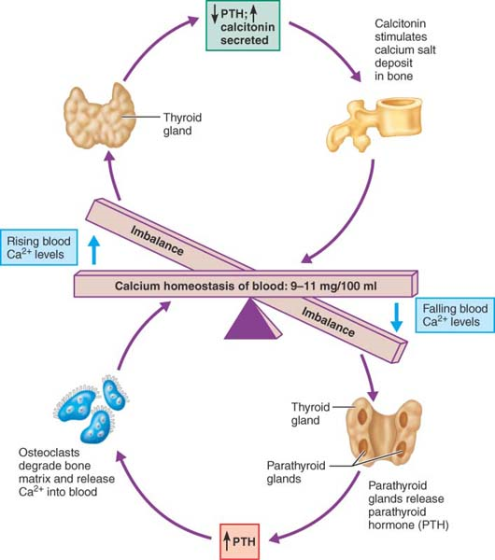
Hormonal control of blood calcium levels. PTH and to a lesser extent calcitonin operate in negative feedback fashion to control blood calcium levels.

Slide 38
Response to Mechanical Stress
The second set of controls regulating bone remodeling, bone’s response to mechanical stress (muscle pull) and gravity, serves the needs of the skeleton by keeping the bones strong where stressors are acting. Wolff’s law holds that a bone grows or remodels in response to the demands placed on it. The first thing to understand is that a bone’s anatomy reflects the common stresses it encounters. For example, a bone is loaded (stressed) whenever weight bears down on it or muscles pull on it. This loading is usually off center, however, and tends to bend the bone. Bending compresses the bone on one side and subjects it to tension (stretching) on the other (Figure 6.12). But both forces are minimal toward the center of the bone (they cancel each other out), so a bone can “hollow out” for lightness (using spongy bone instead of compact bone) without jeopardy.

Slide 39
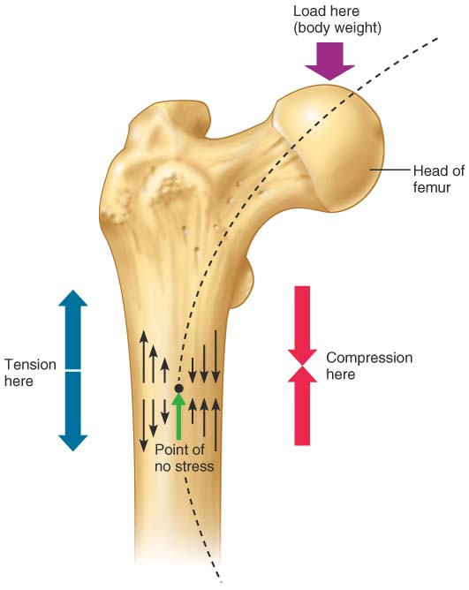
Bone anatomy and stress. When loaded, bones are subjected to bending stress. In this example using the femur of the thigh, body weight transmitted to the head of the femur threatens to bend the bone along the indicated arc. This bending compresses the bone on one side (converging arrows), and stretches it on the other side (diverging arrows). Because these two forces cancel each other internally, much less bone material is needed internally than superficially.

Slide 40
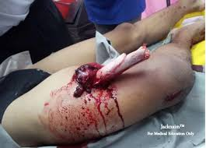
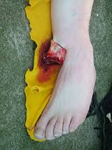
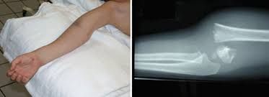
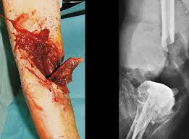
Bone Repair
Despite their remarkable strength, bones are susceptible to fractures, or breaks.
During youth, most fractures result from exceptional trauma that twists or smashes the bones (sports injuries, automobile accidents, and falls, for example).
In old age, most fractures occur as bones thin and weaken.

Slide 41
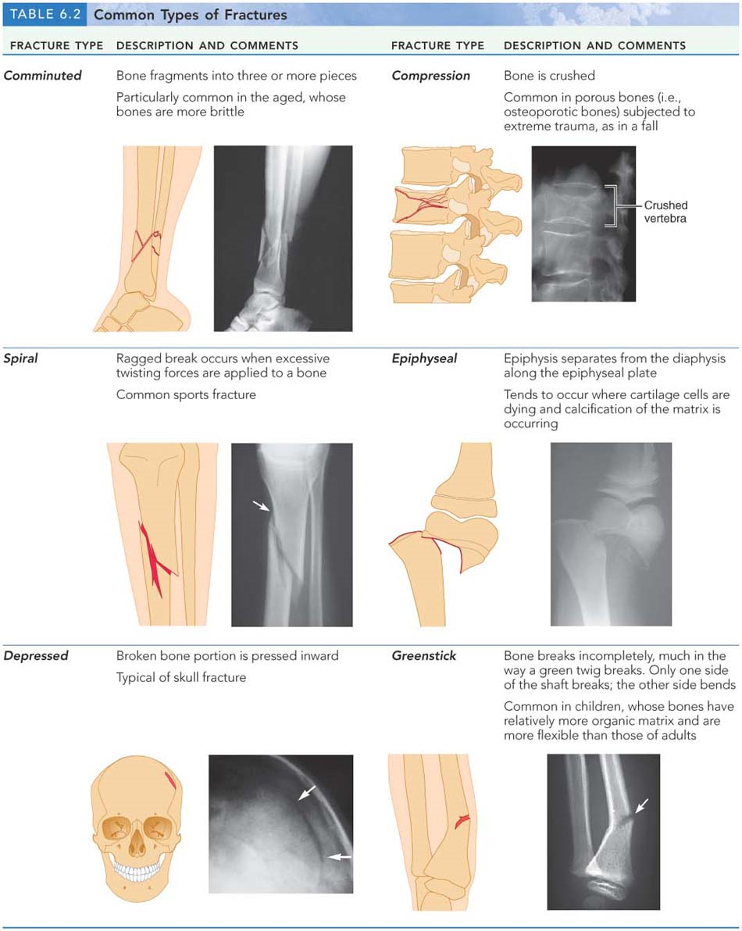
s

Slide 44
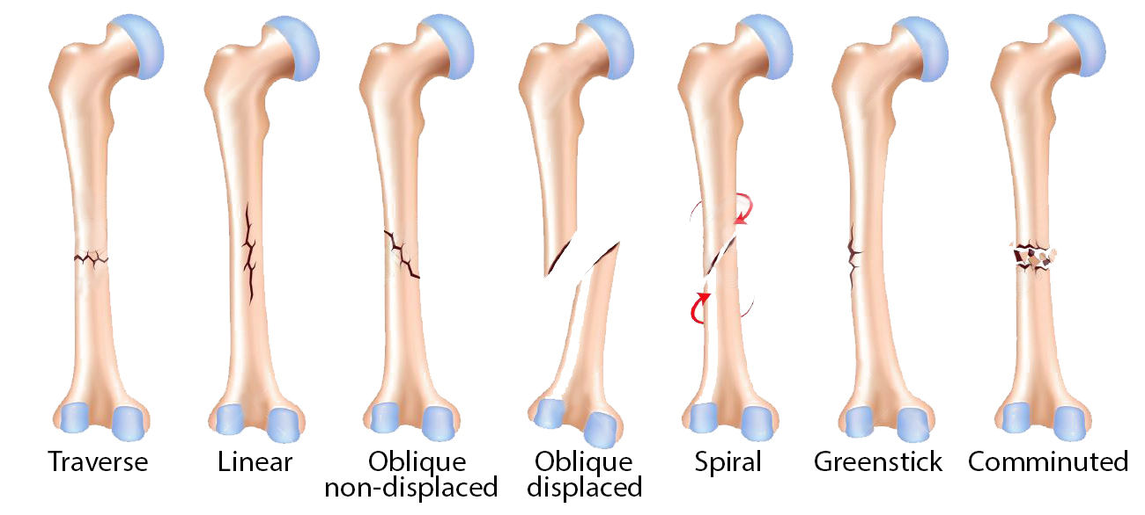

Slide 45
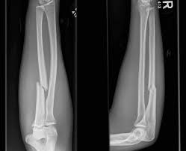
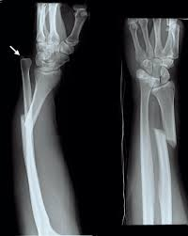

Slide 46
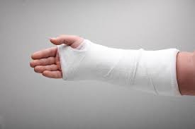
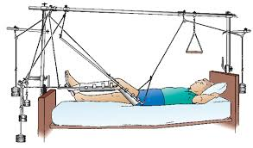
A fracture is treated by reduction, the realignment of the broken bone ends.
In closed or external reduction, the bone ends are coaxed into position by the physician’s hands. In open (internal) reduction, the bone ends are secured together surgically with pins or wires.
After the broken bone is reduced, it is immobilized either by a cast or traction to allow the healing process to begin.
For a simple fracture the healing time is six to eight weeks for small or medium-sized bones in young adults, but it is much longer for large, weight-bearing bones and for bones of elderly people (because of their poorer circulation).

Slide 47
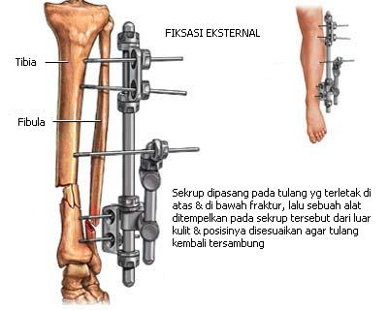
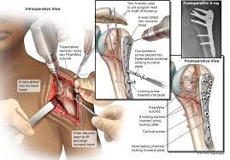

Slide 48
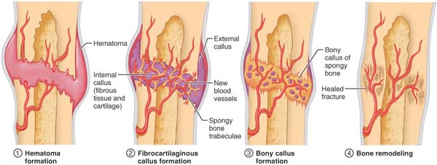
Repair in a simple fracture involves four major stages

Slide 49
Hematoma formation.
When a bone breaks, blood vessels in the bone and periosteum, and perhaps in surrounding tissues, are torn and hemorrhage.
As a result, a hematoma (he″mah-to′mah), a mass of clotted blood, forms at the fracture site. Soon, bone cells deprived of nutrition die, and the tissue at the site becomes swollen, painful, and inflamed.

Slide 50
Fibrocartilaginous callus formation.
Within a few days, several events lead to the formation of soft granulation tissue, also called the soft callus (kal′us; “hard skin”). Capillaries grow into the hematoma and phagocytic cells invade the area and begin cleaning up the debris, begin reconstructing the bone. The fibroblasts produce collagen fibers that span the break and connect the broken bone ends.
Within this mass of repair tissue, osteoblasts begin forming spongy bone. This entire mass of repair tissue, now called the fibrocartilaginous callus, splints the broken bone.

Slide 51
Bony callus formation.
Within a week, new bone trabeculae begin to appear in the fibrocartilaginous callus and gradually convert it to a bony (hard) callus of spongy bone.
Bony callus formation continues until a firm union is formed about two months later.

Slide 52
Bone remodeling.
Beginning during bony callus formation and continuing for several months after, the bony callus is remodeled.
The excess material on the diaphysis exterior and within the medullary cavity is removed, and compact bone is laid down to reconstruct the shaft walls.
The final structure of the remodeled area resembles that of the original unbroken bony region because it responds to the same set of mechanical stressors.

Slide 53
Osteoporosis
For most of us, the phrase “bone problems of the elderly” brings to mind the stereotype of a victim of osteoporosis—a hunched-over old woman shuffling behind her walker.
Osteoporosis (os″te-o-po-ro′sis) refers to a group of diseases in which bone resorption outpaces bone deposit. The bones become so fragile that something as simple as a hearty sneeze or stepping off a curb can cause them to break.
The composition of the matrix remains normal but bone mass is reduced, and the bones become porous and light.
Even though osteoporosis affects the entire skeleton, the spongy bone of the spine is most vulnerable, and compression fractures of the vertebrae are common. The femur, particularly its neck, is also very susceptible to fracture (called a broken hip) in people with osteoporosis.

Slide 54
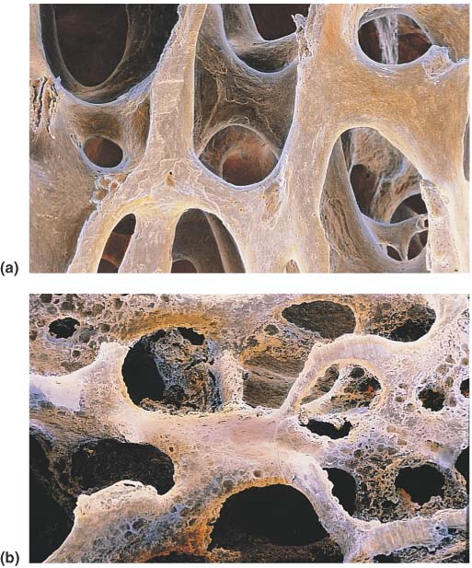
Normal versus osteoporotic bone.
The contrasting architecture of (a) normal bone and (b) osteoporotic bone as shown in scanning electron micrographs (both 300×).

Slide 55
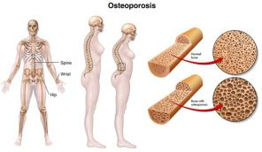
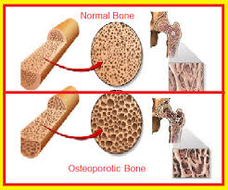
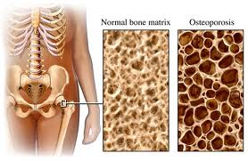

Slide 56
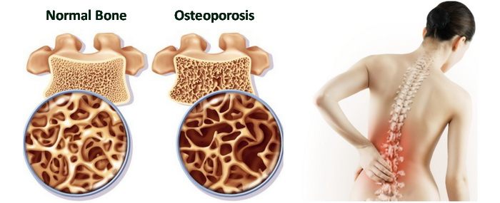
Osteoporosis is a progressive skeletal disease characterized by loss of bone mass due to imbalance of bone formation and bone resorption.
Osteoblasts and osteoclasts are types of cells the human body uses to repair broken bones. Osteoclasts break down old bone tissue allowing osteoblasts to replace it with new material.
The condition is characterized by low bone density and bone fragility. Affected bones become porous and brittle and susceptible to fractures, especially at the hip, spine, and wrist.

Slide 57
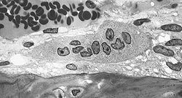
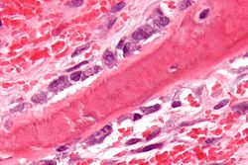
An osteoclast is a type of bone cell that breaks down bone tissue. This function is critical in the maintenance, repair, and remodelling of bones of the vertebral skeleton. The osteoclast disassembles and digests the composite of hydrated protein and mineral at a molecular level by secreting acid and a collagenase, a process known as bone resorption. This process also helps regulate the level of blood calcium.
Osteoblast are cells with a singlenucleus that synthesize bone. However, in the process of bone formation, osteoblasts function in groups of connected cells.

Slide 58
Sub-Chapter Test

